Slide 1
PRESENTATION ON CAMPUS RECRUITMENT SYSTEM
Submitted By-
Bijay Nath(CSM20023)
Amlan Jyoti Talukdar(CSM20051)
Guided By-
Professor Bhogeswar Borah

Slide 2
CONTENT
Introduction
Objective of the system
Advantage of the System
Technologies used
Data Flow Diagram
ER-Diagram
Relational Schema
Snapshots
Future Scope
Conclusion

Slide 3
INTRODUCTION
Campus Recruitment System is a web application which provides an easy way for in-campus recruitment of the students by different companies and also provides the facility for students to apply for different jobs. The system is managed by the campus placement cell where different companies register to hire students from different programmes by providing company details, job description etc.

Slide 4
OBJECTIVES
The main motive to implement this system is to eliminate the existing system of recruitment where the records were stored in excel sheets. Hence updating records is a very time consuming tasks. Data redundancy also occurs due to the duplication of files and records.
To aware the students about the training and placement cell activity held in their institutions.
.

Slide 5
ADVANTAGES
Reduces the Manual work of existing system.
Saves time and energy which are spending in making reports and collecting data.
No duplication of work.
It can be accessed throughout the institution with proper login provided.

Slide 6
TECHNOLOGIES USED
Front-end technology: HTML and CSS
Back-end technology: PHP and MySQL
Framework: Bootstrap
Server: Xampp Server

Slide 7
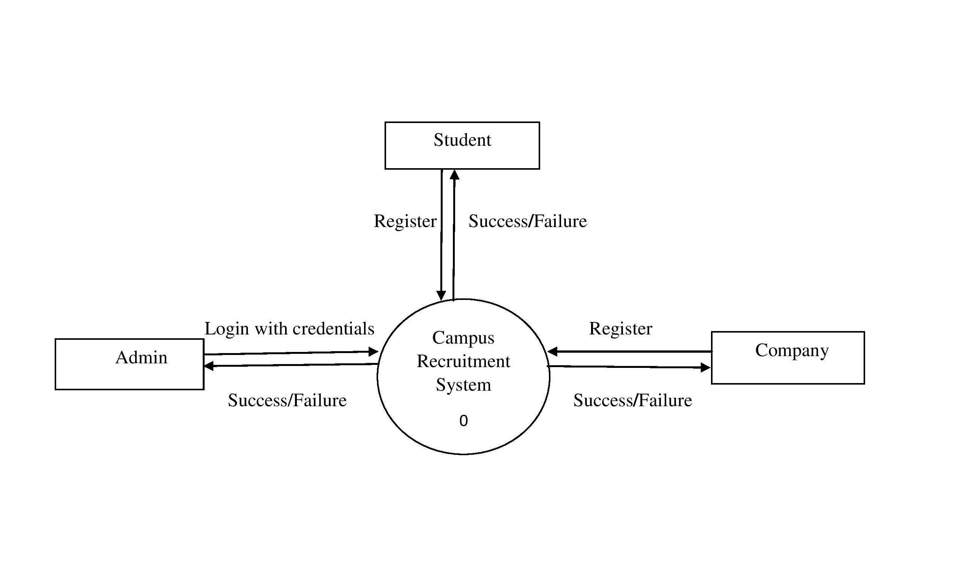
DATA FLOW DIAGRAM CONTEXT DIAGRAM

Slide 8
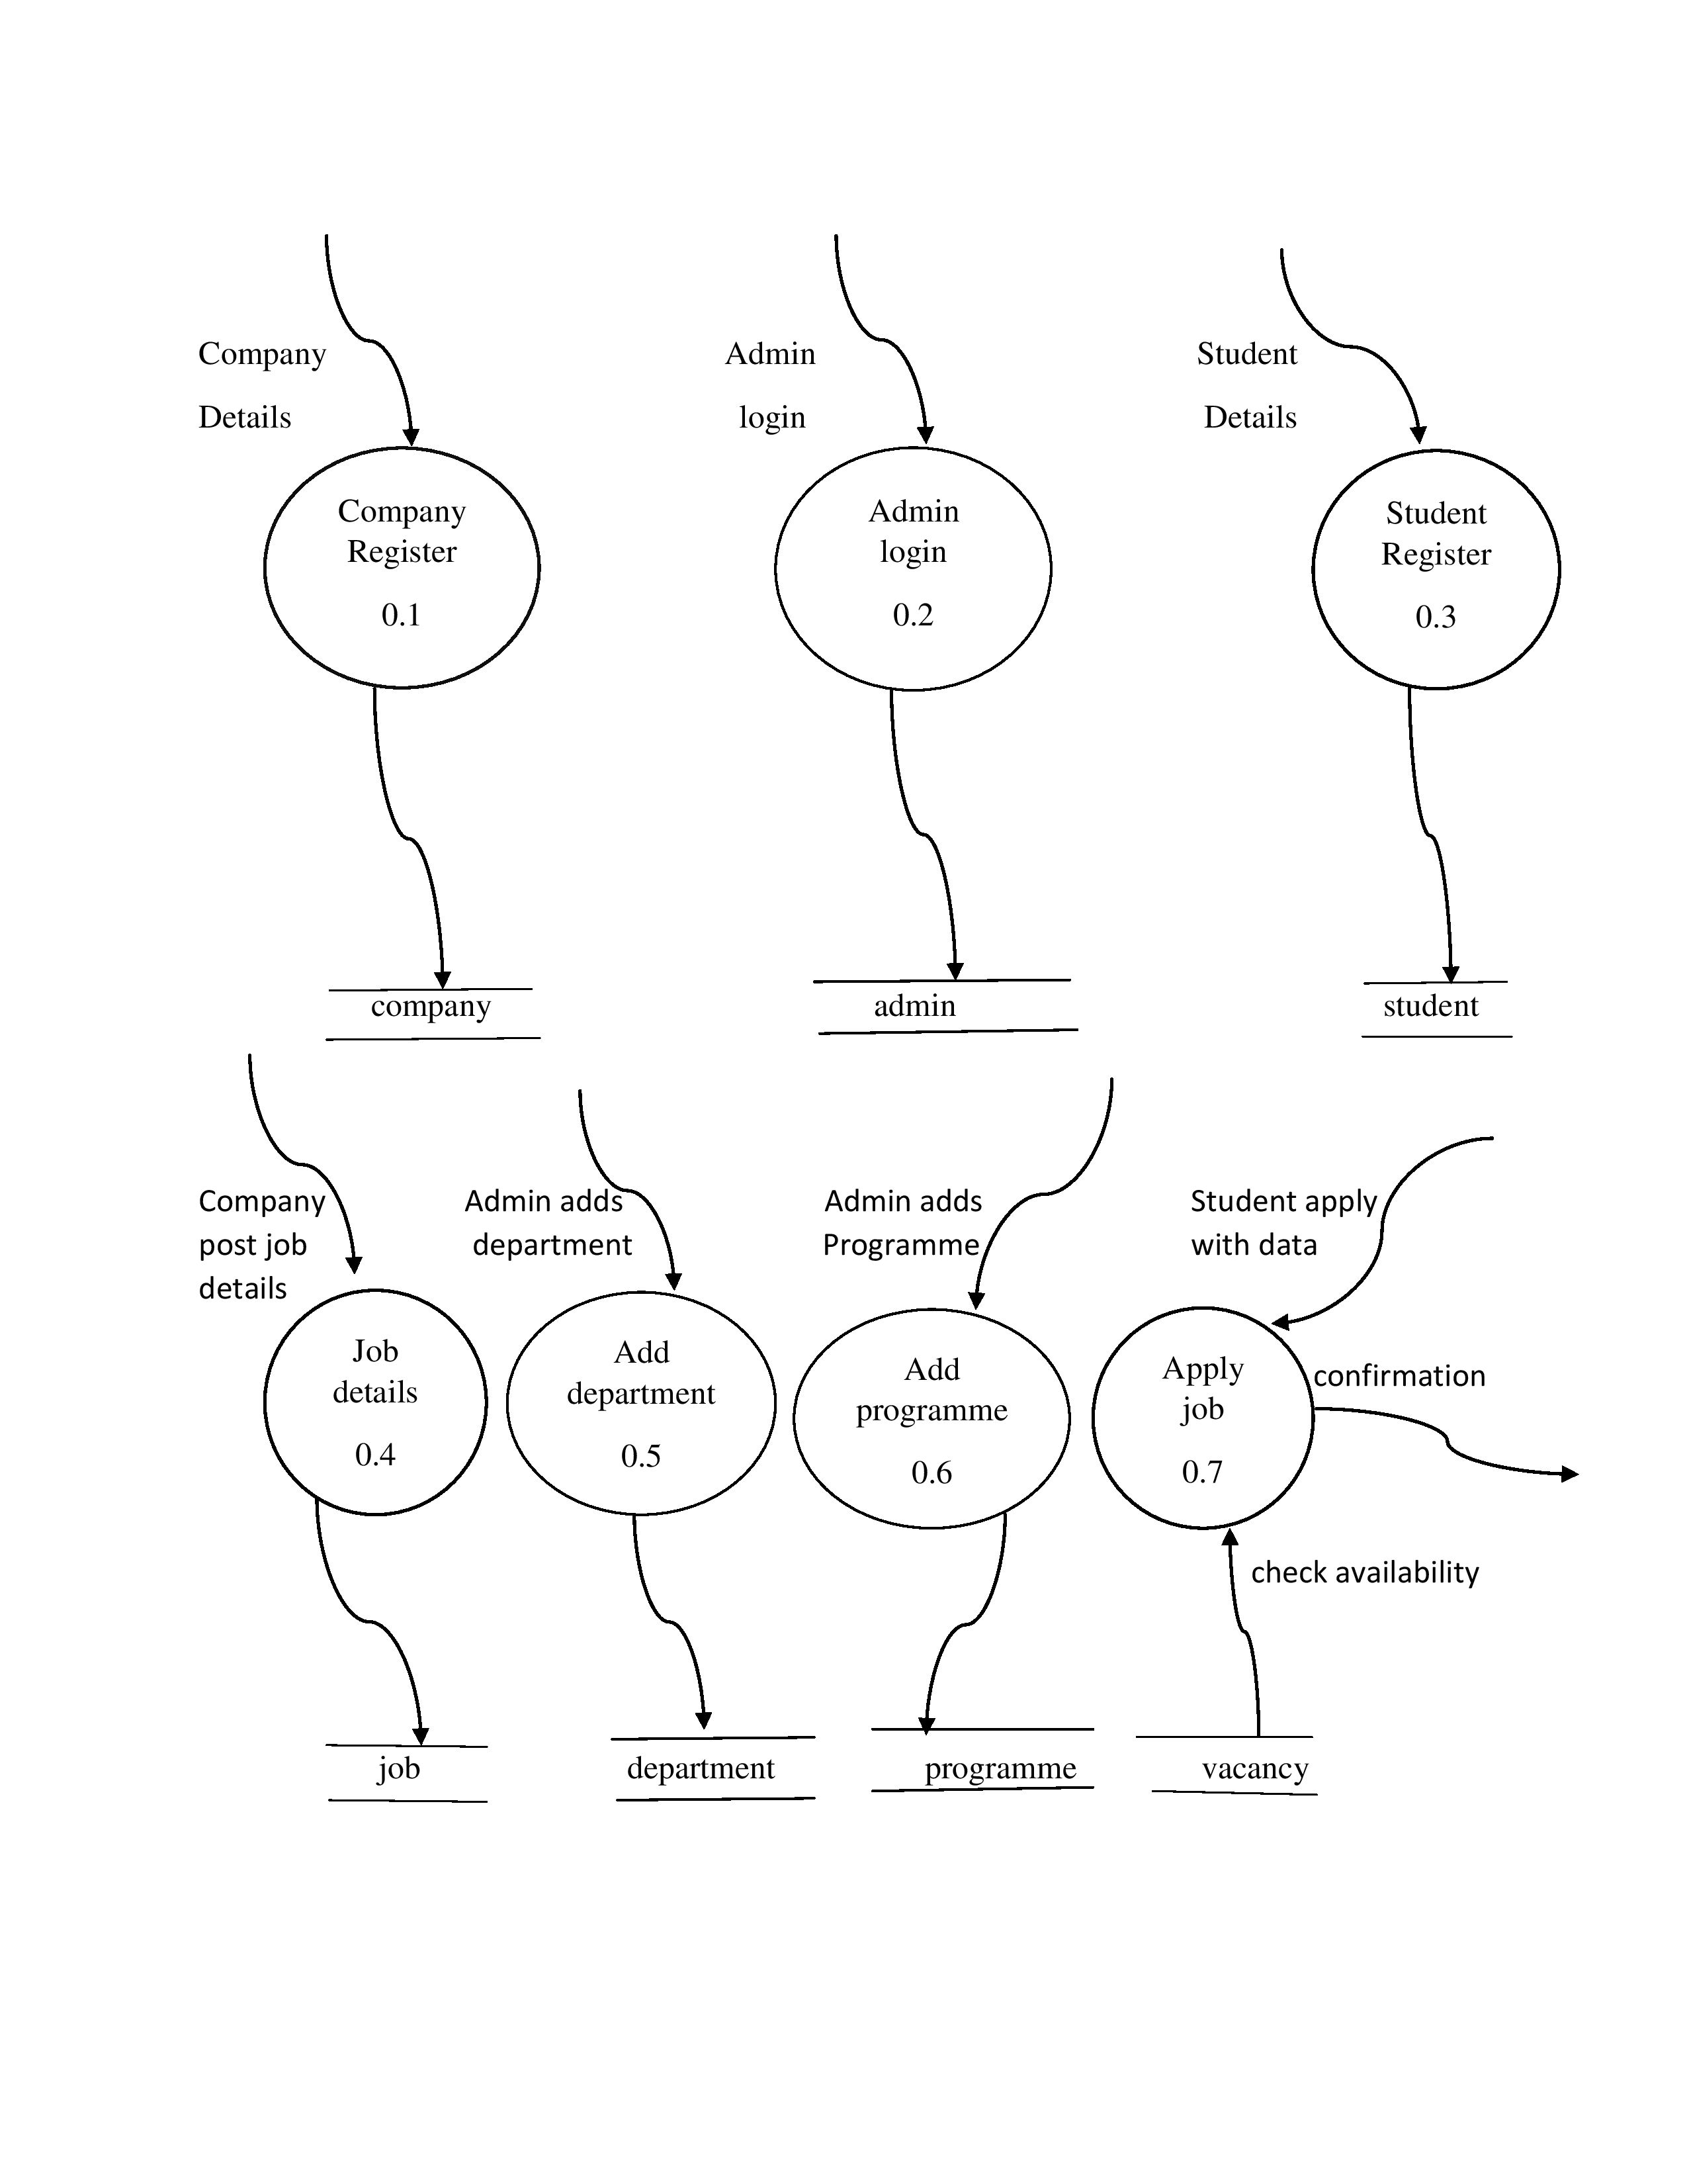
LEVEL 1 DFD

Slide 9
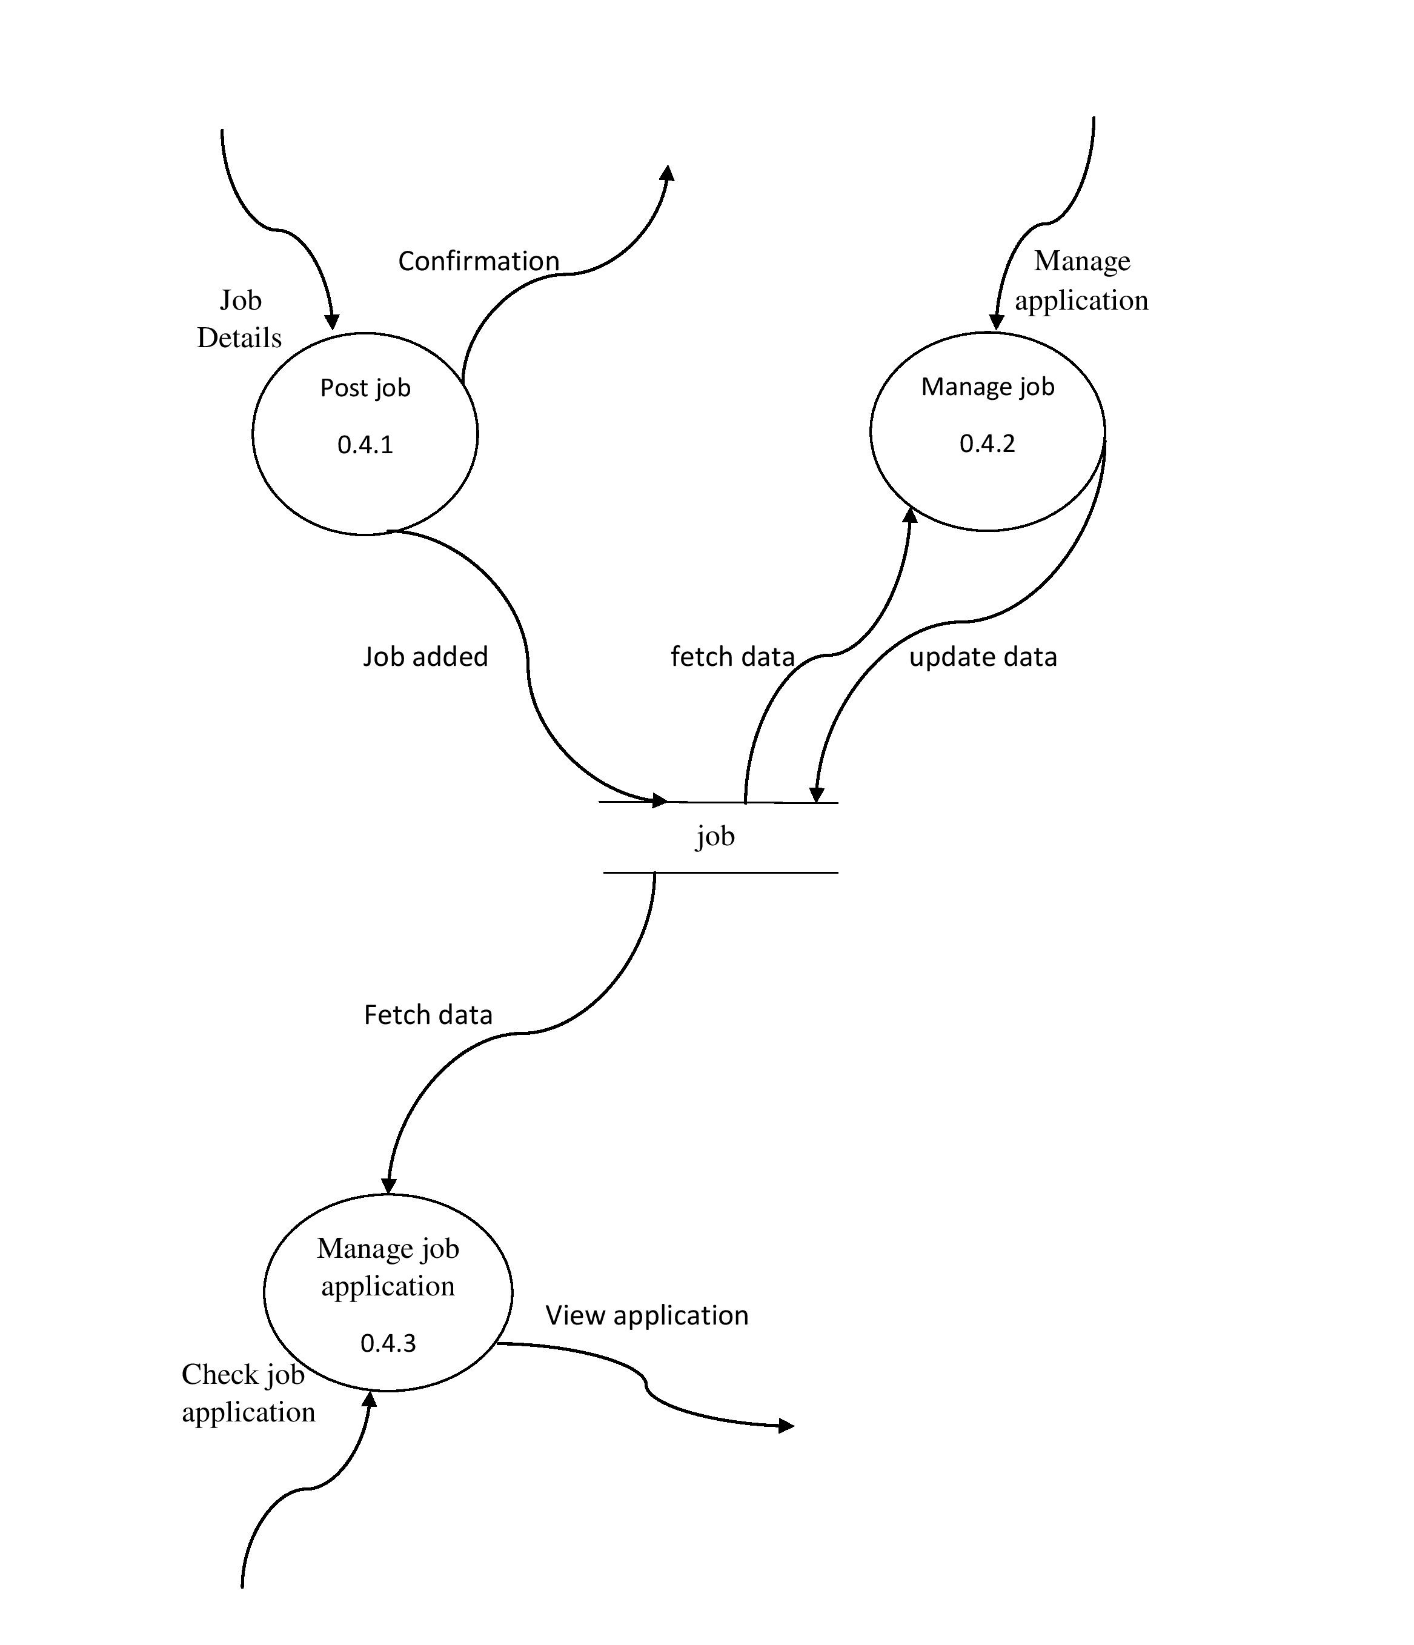
LEVEL 2 DFD FOR JOB DETAILS

Slide 10
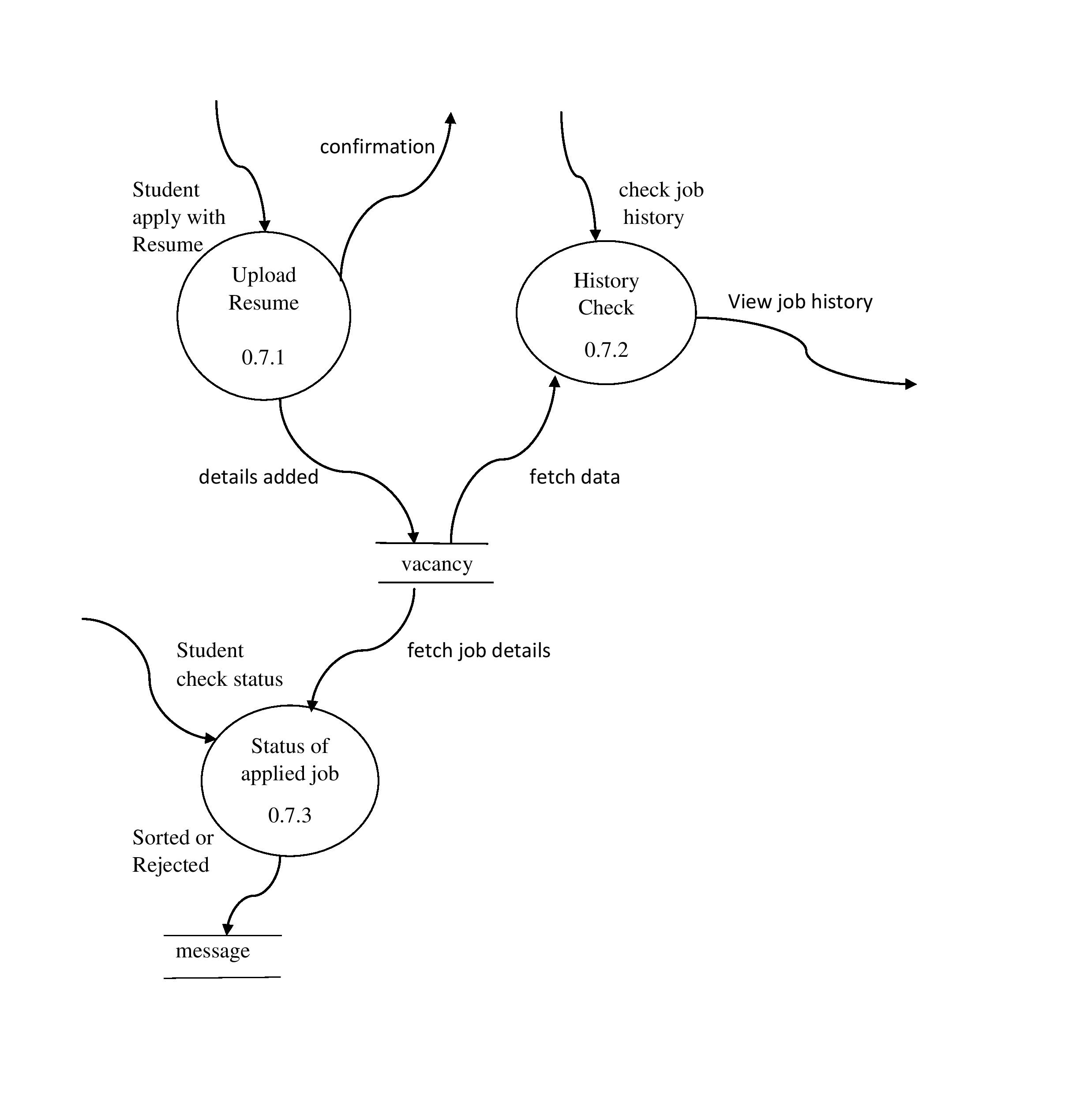
LEVEL 2 DFD FOR APPLY JOB

Slide 11
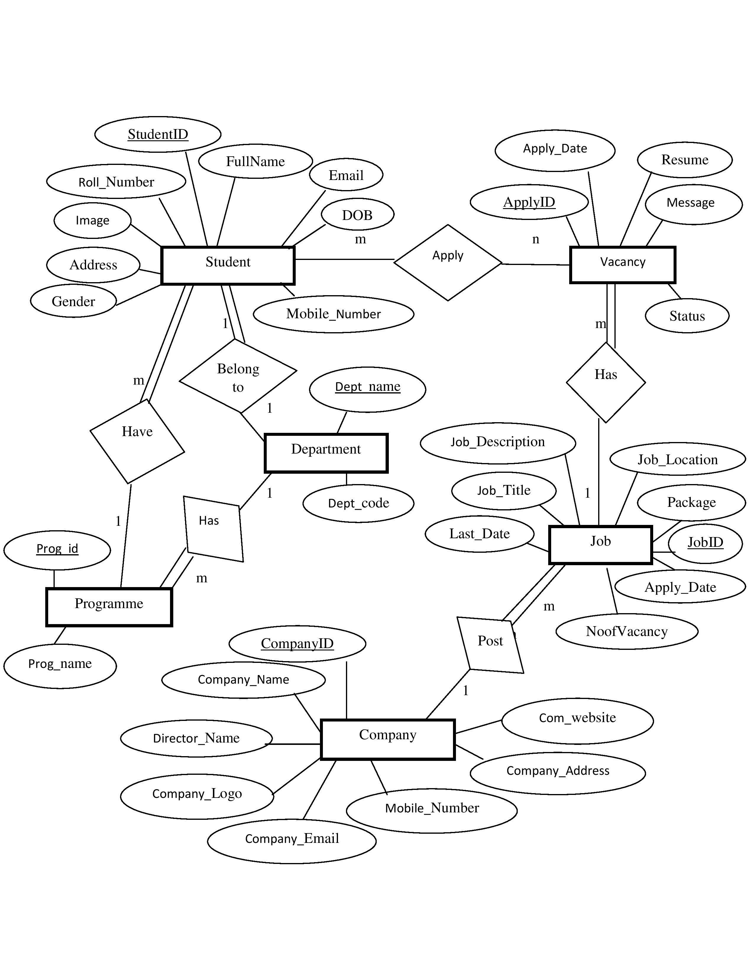
ER DIAGRAM

Slide 12
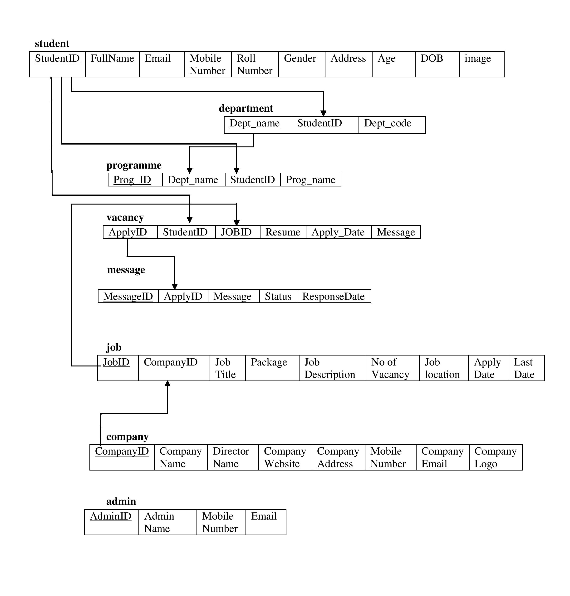
RELATIONAL MODEL

Slide 13
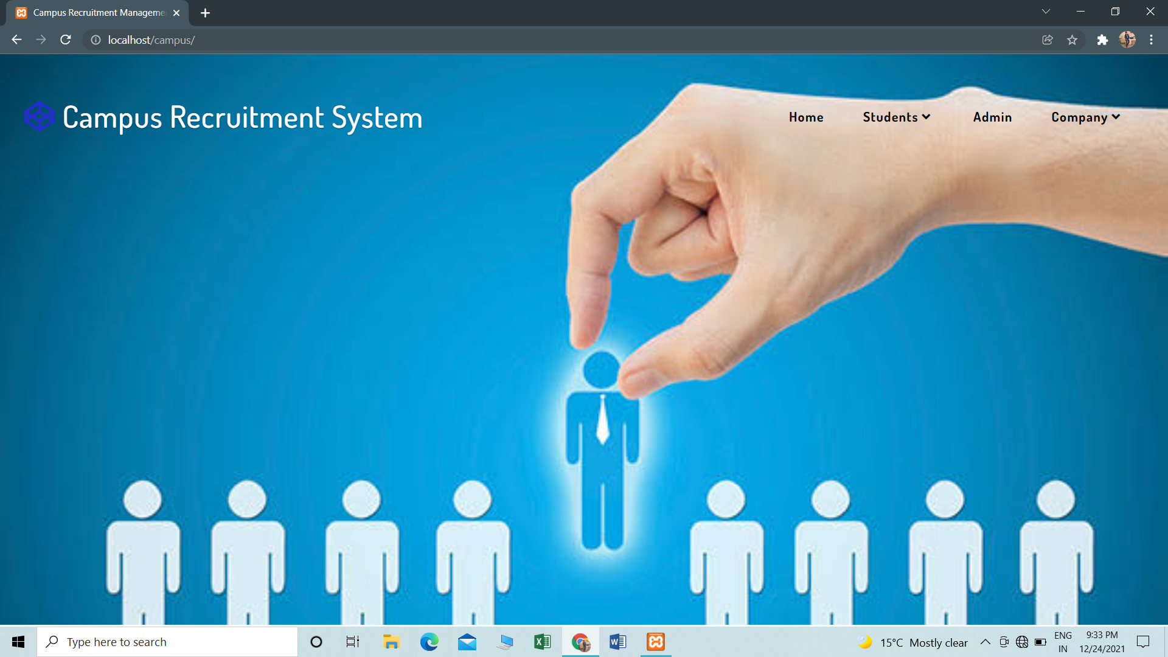
SNAPSHOT

Slide 14
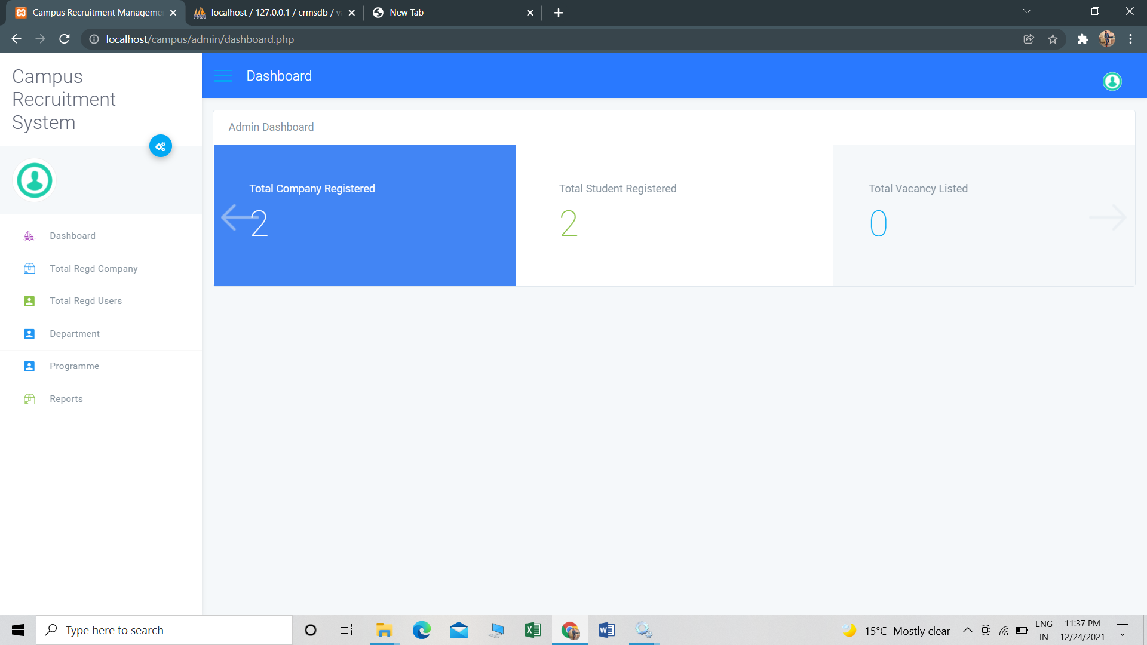
ADMIN DASHBOARD

Slide 15
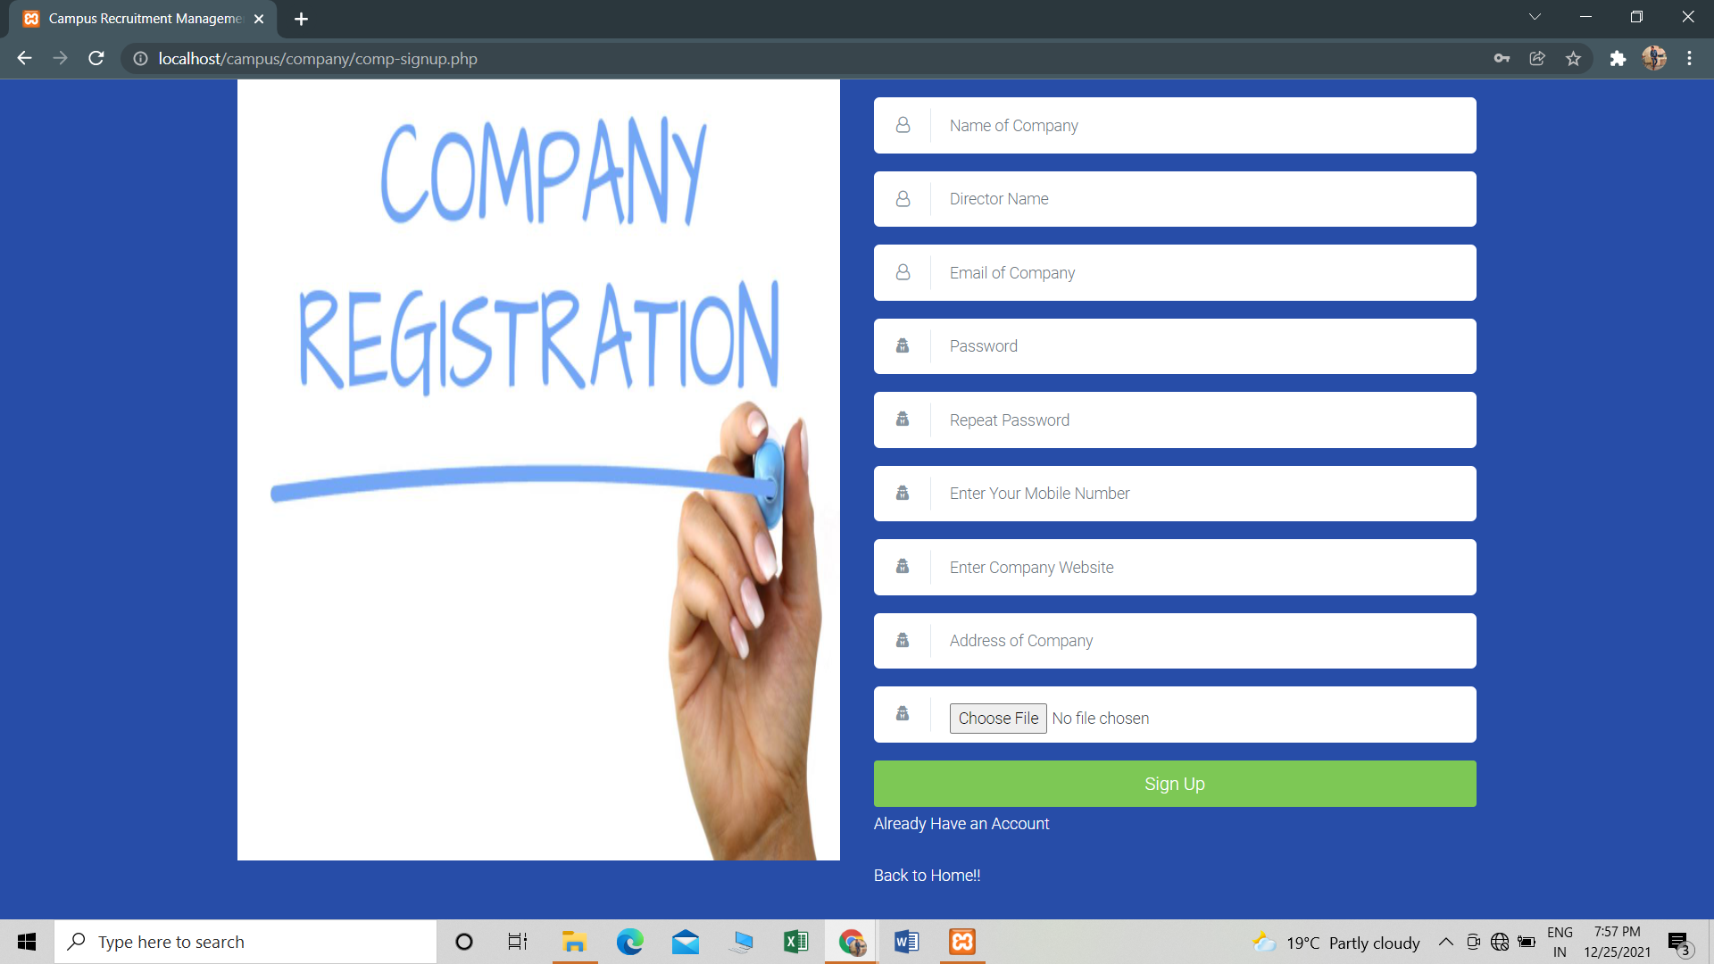
COMPANY REGISTER

Slide 16
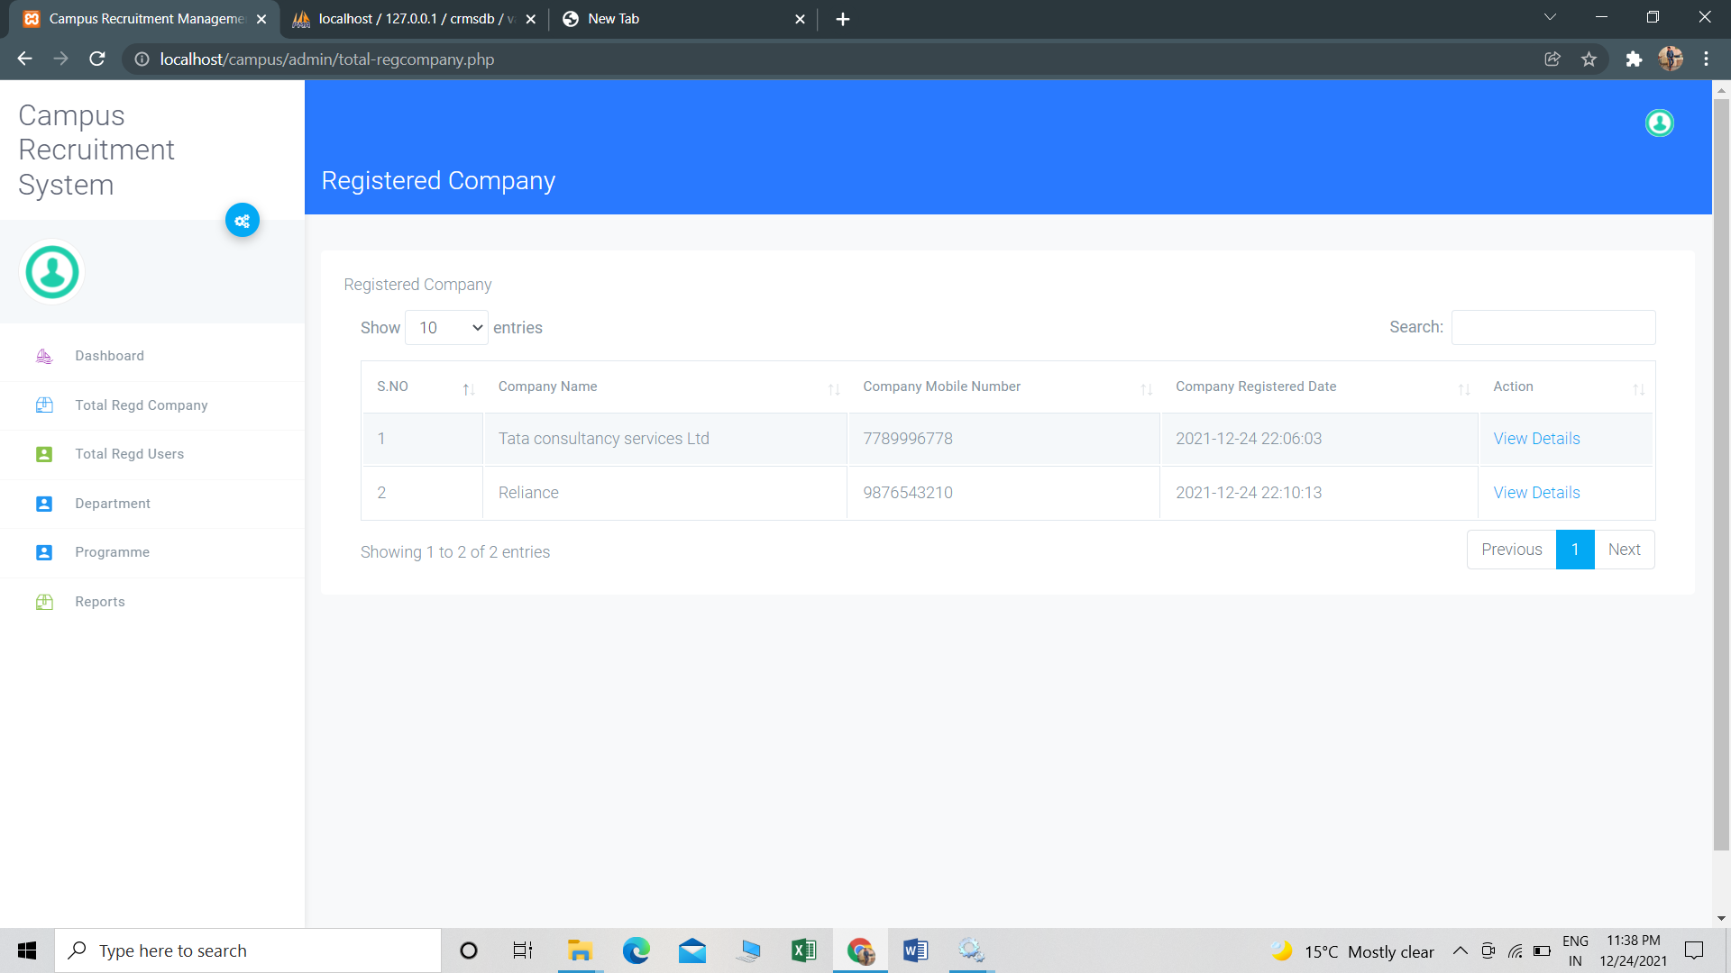
REGISTERD COMPANY

Slide 17
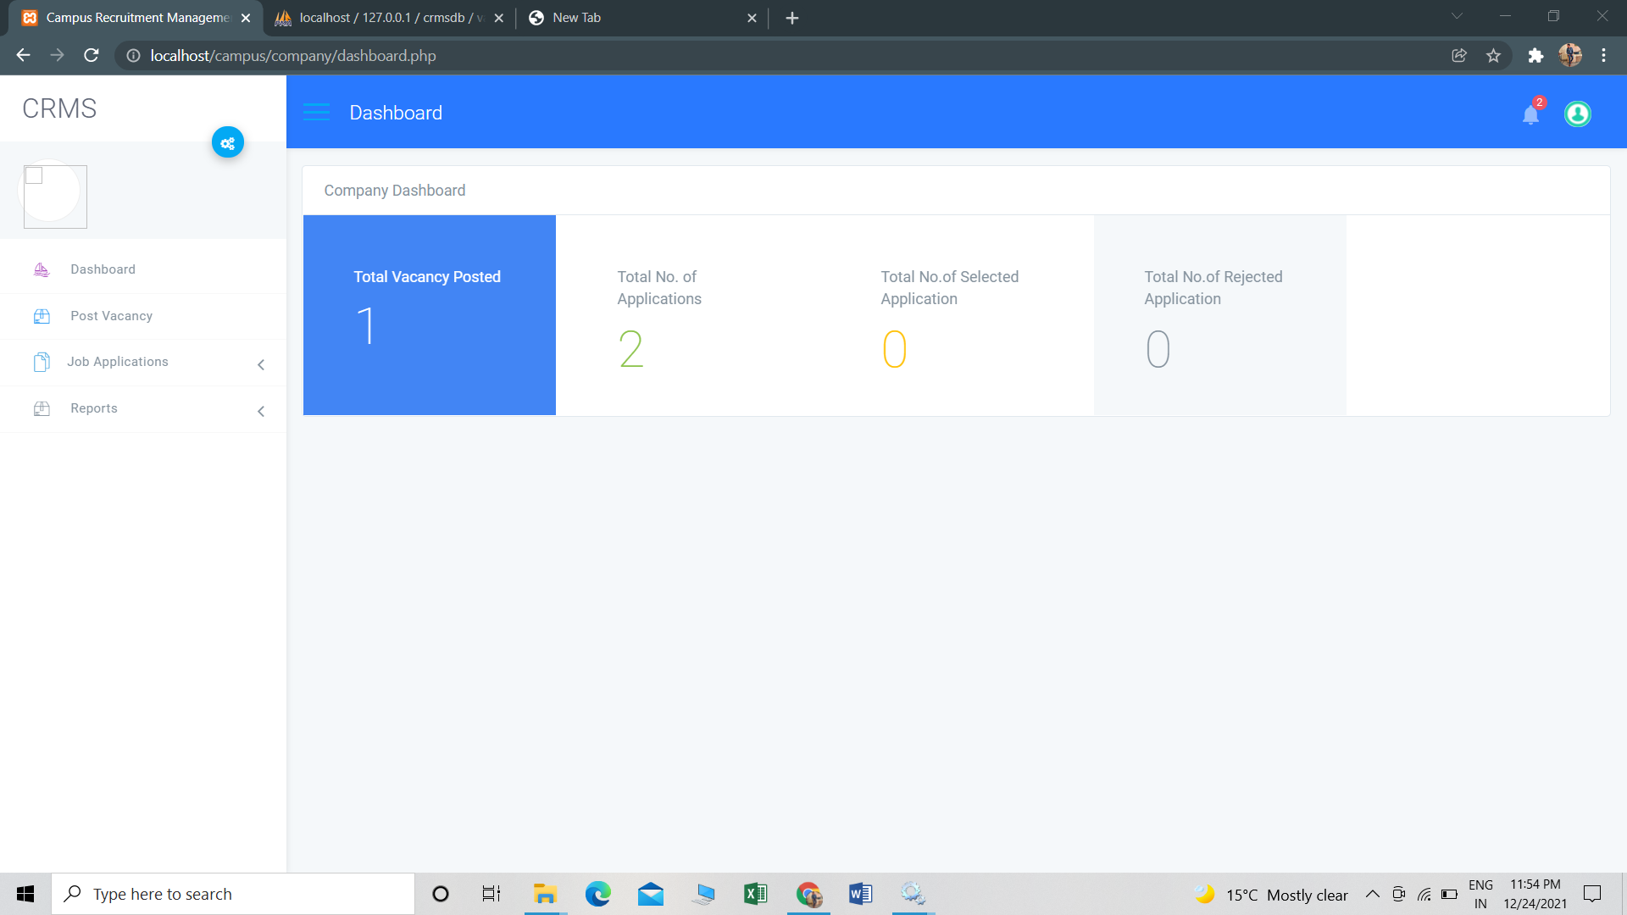
COMPANY DASHBOARD

Slide 18
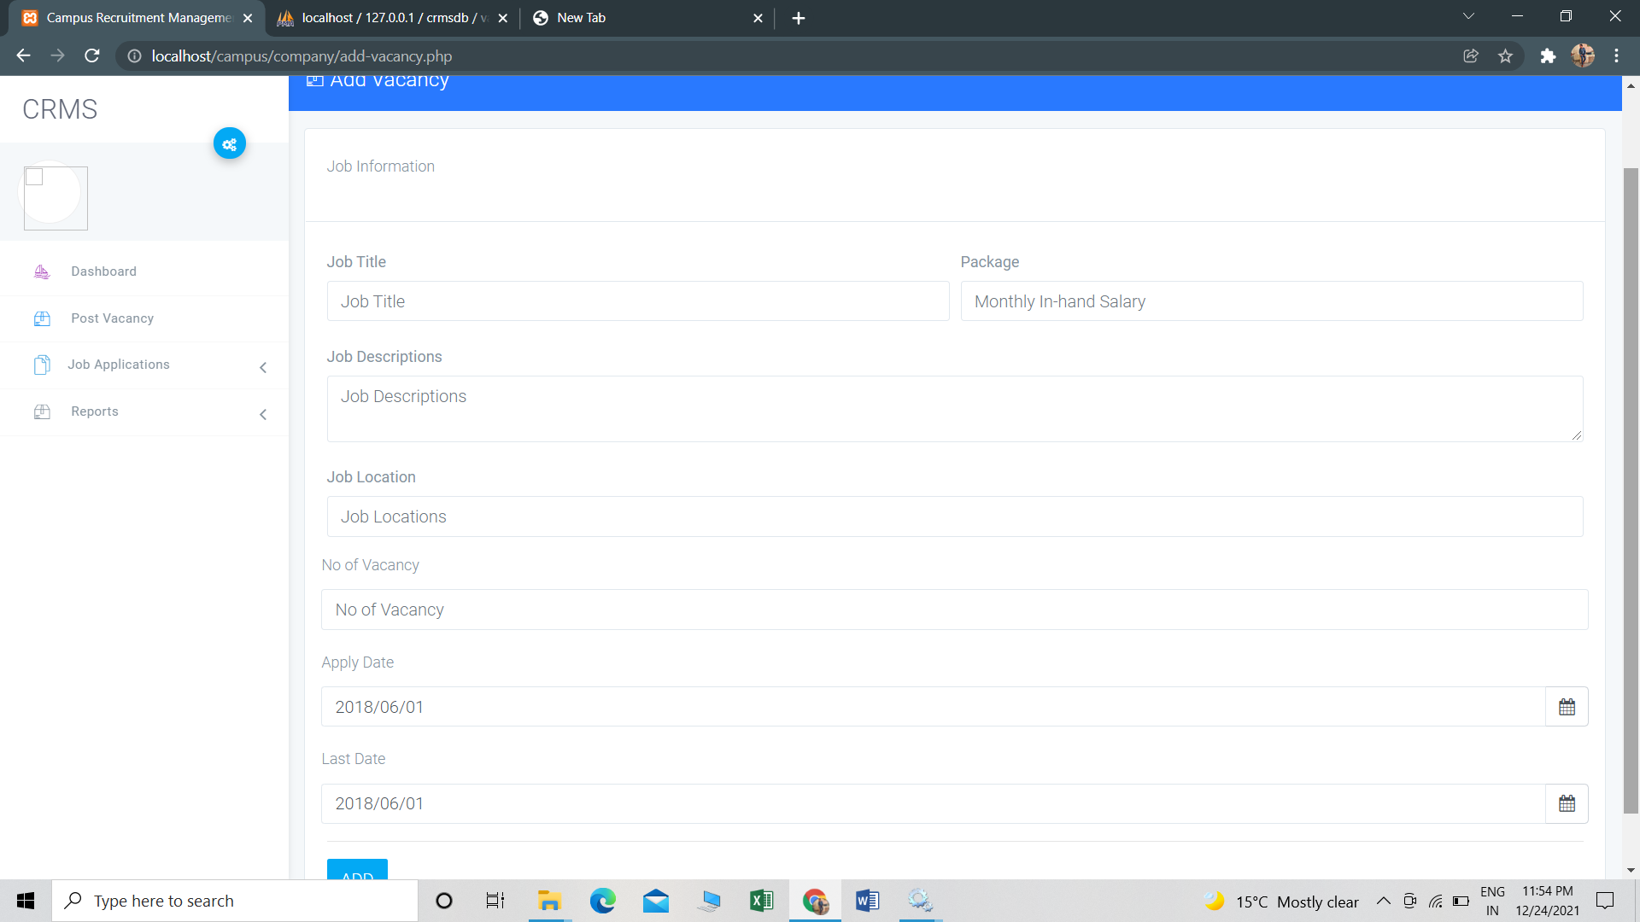
ADD JOB DETAILS

Slide 19
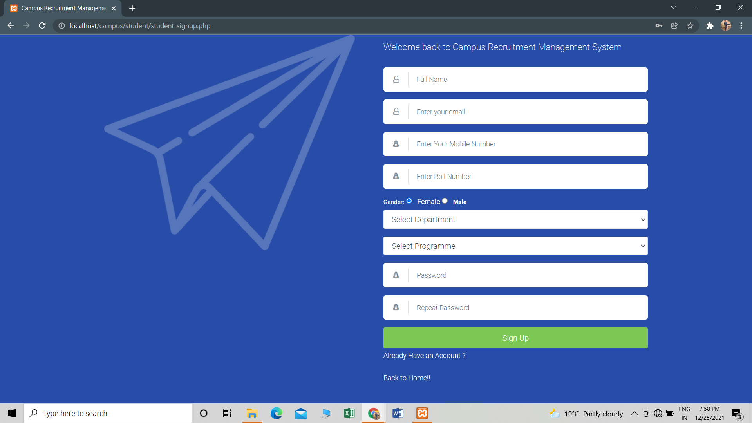
STUDENT REGISTER

Slide 20
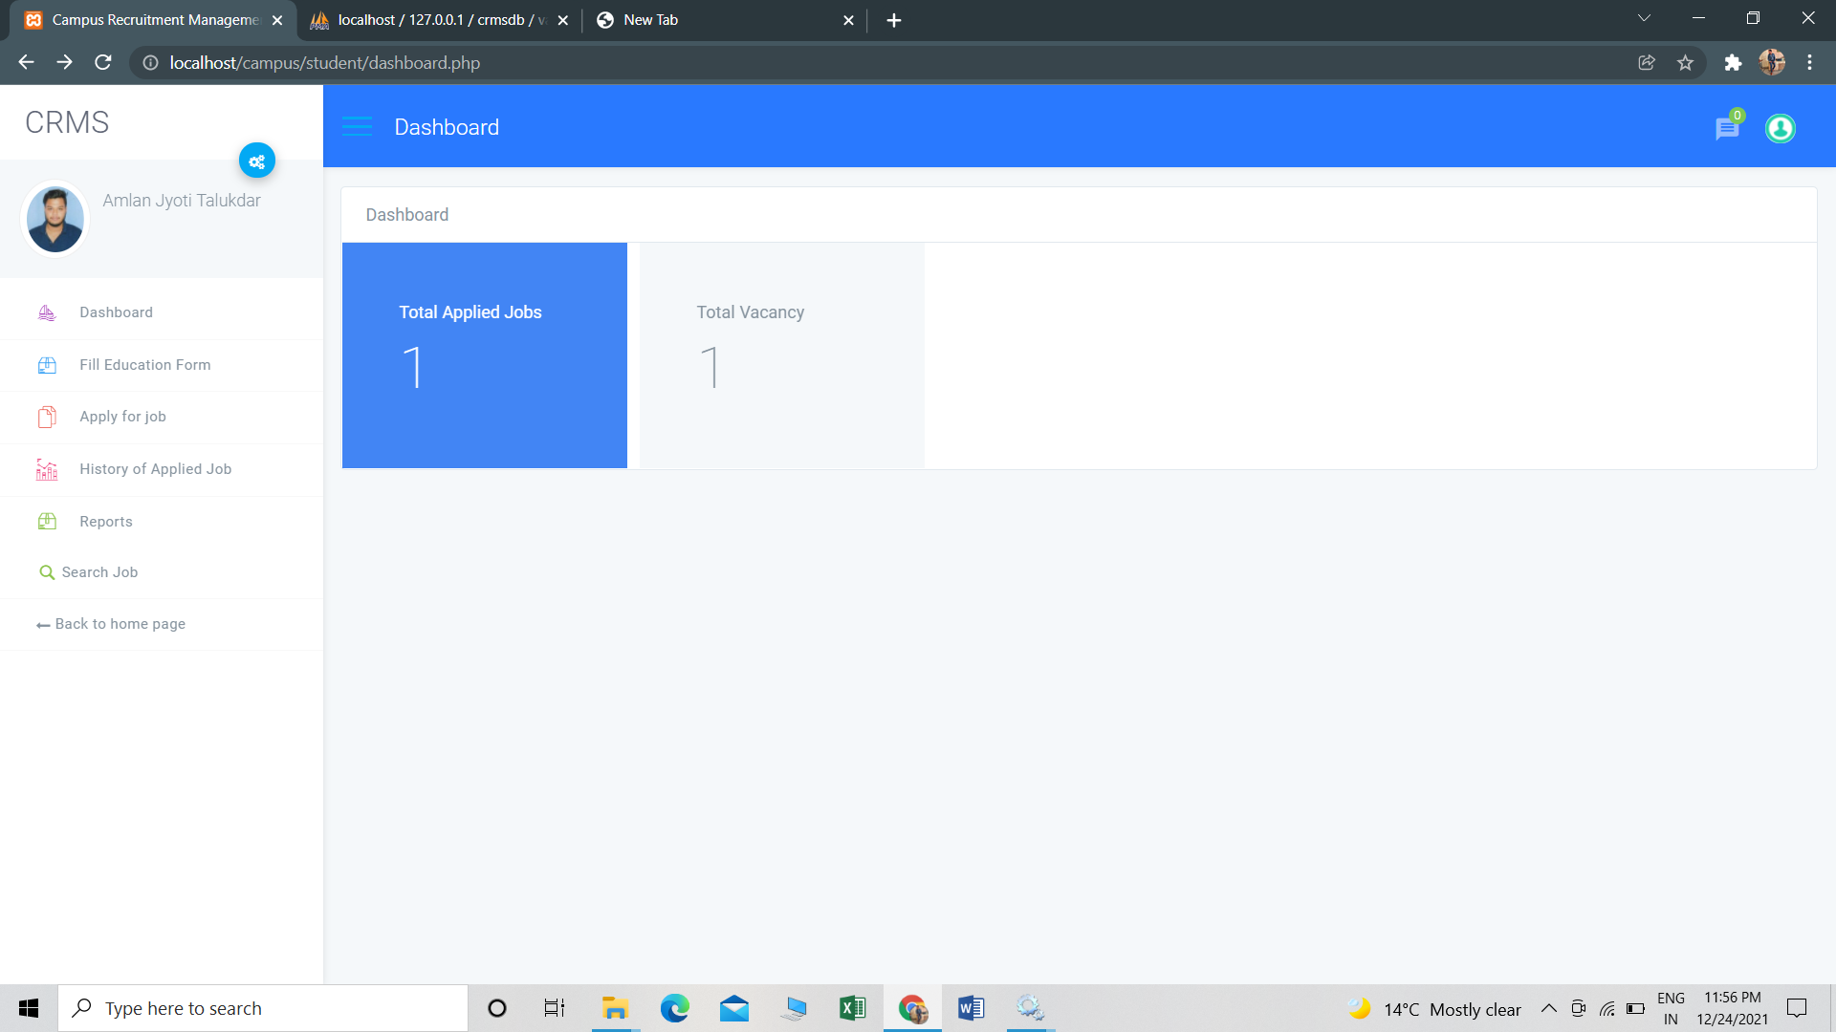
STUDENT DASHBOARD

Slide 21
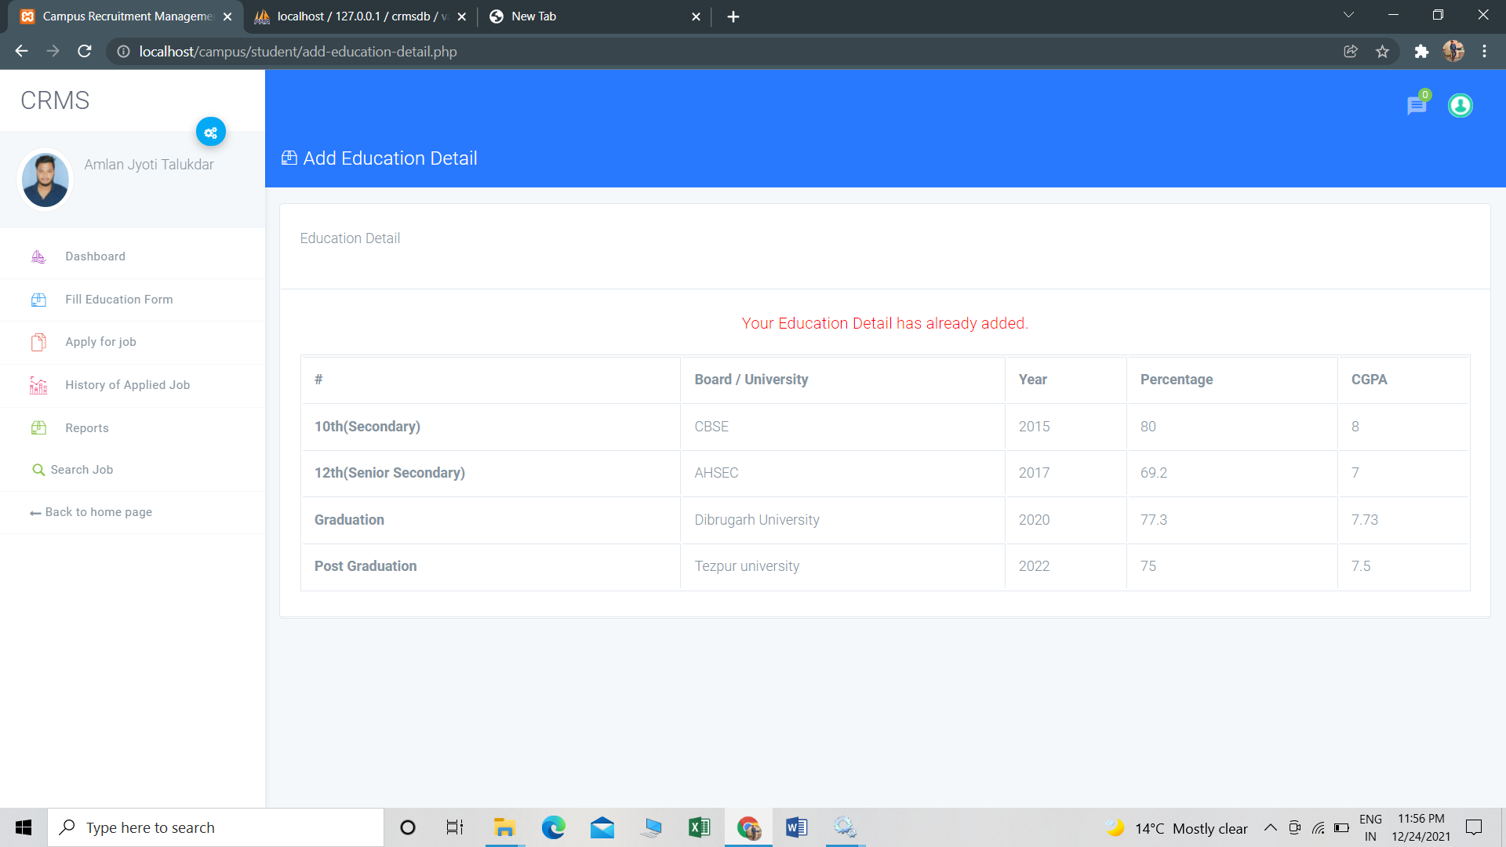
ADD EDUCATIONAL DETAILS

Slide 22
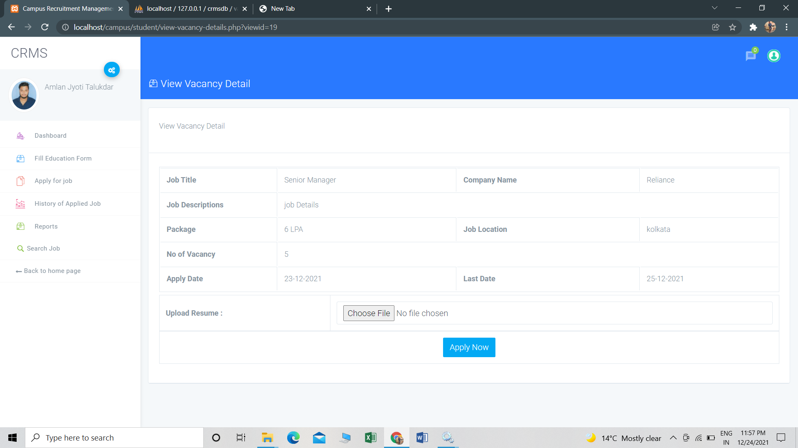
APPLY FOR JOB

Slide 23
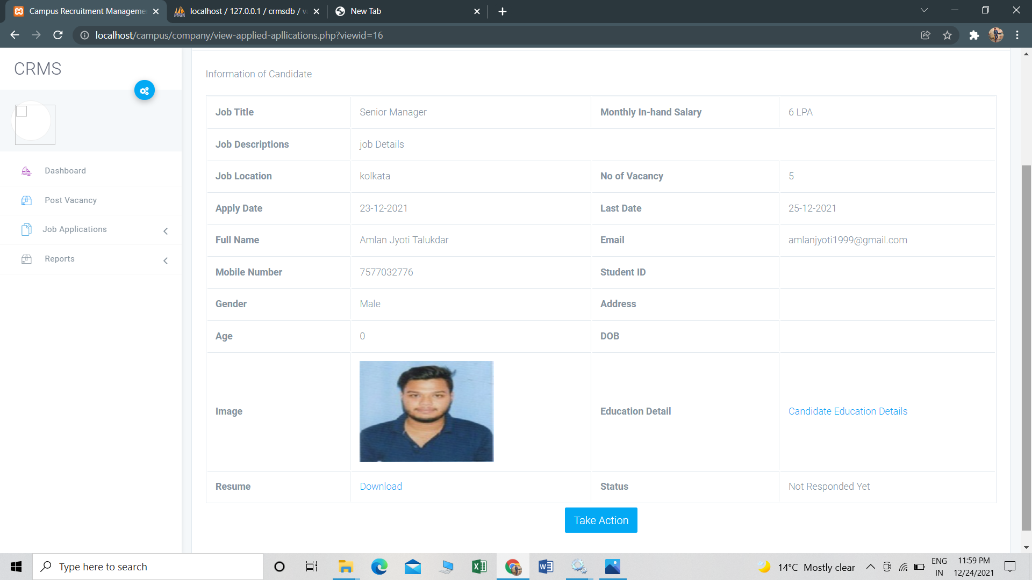
COMPANY VIEW APPLIED APPLICATIONS

Slide 24
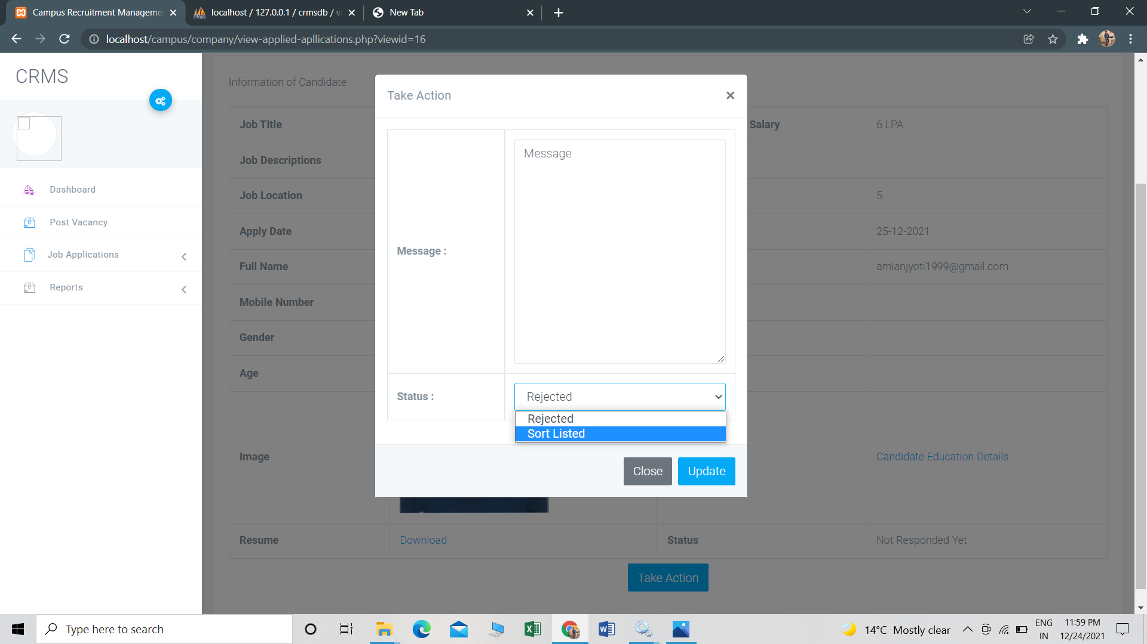
COMPANY TAKE NECESSARY ACTION

Slide 25
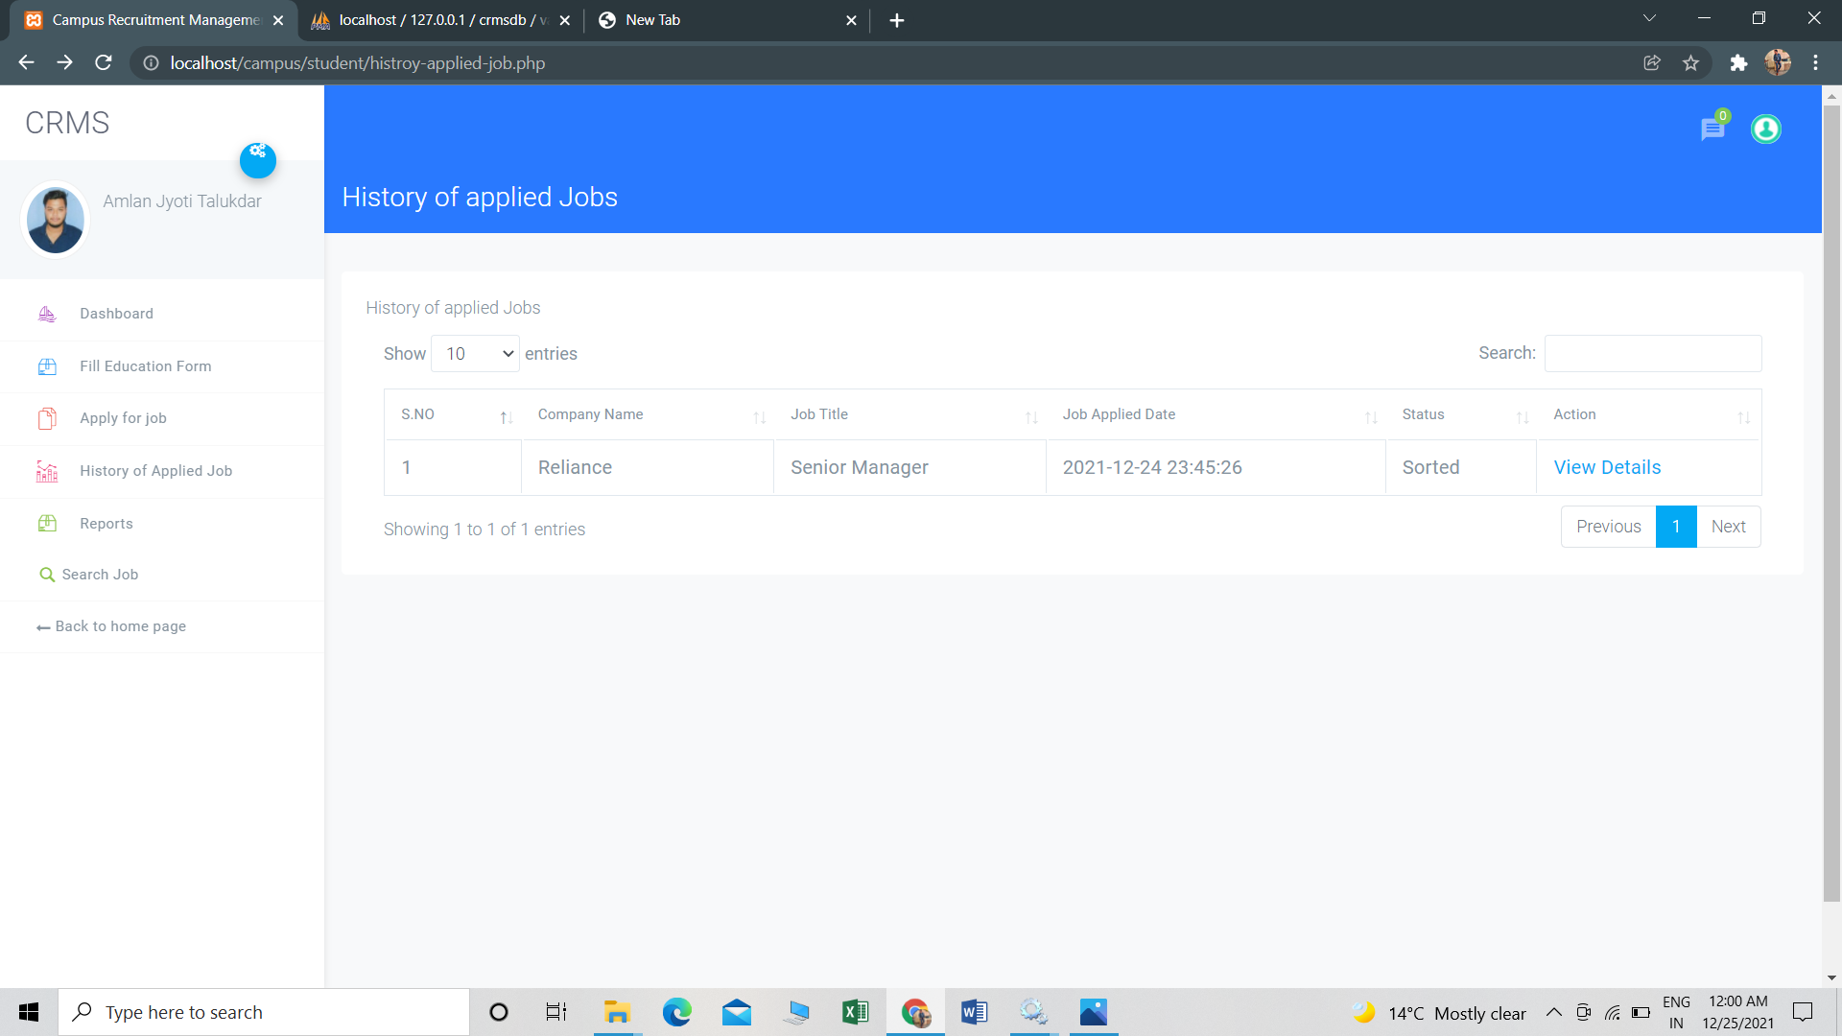
HISTORY OF APPLIED JOB

Slide 26
FUTURE SCOPE
In proposed recruitment system there is scope for improvement of the system. System is not providing the SMS integration. Hence, it can be modified to give the SMS integration.
Apart from these there is scope for generating many more features. In the future we can place the system on the cloud so the maintenance of the data can be reduced.
The Exam system will integrate with the online recruitment system so the student can get the results directly.
There can be many more future Enhancement & improvement in the Recruitment System as per requirement.

Slide 27
CONCLUSION
From a proper analysis of positive points and constraints on the Campus Recruitment System, it can be safely concluded that the project is a highly client GUI based component. This application is working properly and meeting user requirements.
Nowadays manual process of searching a job of one's choice as well as searching the appropriate candidate for a specific job has become a huge task and so realizing the need for easy management of this process, the site has been developed. It is very easy to update and maintain information through this site.

Slide 28
THANK YOU

